Slide 1
Monté Carlo Simulation
Lab 02

Slide 2
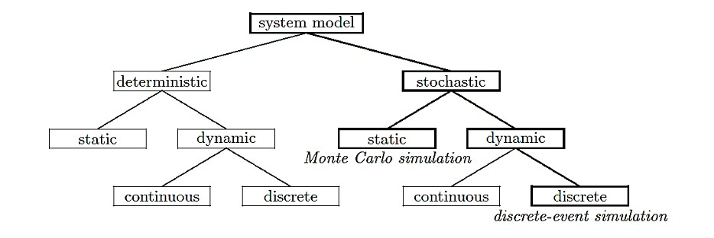
Model Taxonomy

Slide 3
What is Monte Carlo Simulation ?
Monte Carlo methods are a widely used class of computational algorithms for simulating the behavior of various physical and mathematical systems, and for other computations.
Monte Carlo algorithm is often a numerical Monte Carlo method used to find solutions to mathematical problems (which may have many variables) that cannot easily be solved, (e.g. integral calculus, or other numerical methods)

Slide 4
What is Monte Carlo Simulation ?
A Monte Carlo simulation is a statistical simulation technique that provides approximate solutions to problems expressed mathematically. It utilizes a sequence of random numbers to perform the simulation.
This technique can be used in different domains:
complex integral computations,
economics,
making decisions in specific complex problems, …

Slide 5
Random numbers
Uniform Random numbers or pseudo-random numbers (PRN) are essentially independent random variables uniformly Distributed over the unit interval (0,1).
The PRNs are good if they are uniformly distributed, statistically independent and reproducible.

Slide 6
General Algorithm of Monte Carlo Simulation
In general, Monte Carlo Simulation is roughly composed of five steps:
Set up probability distributions: what is the probability distribution that will be considered in the simulation
Build cumulative probability distributions
Establish an interval of random numbers for each variable
Generate random numbers: only accept numbers that satisfies a given condition.
Simulate trials

Slide 7
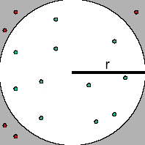
Classic Example
Find the value of π ?
Use the reject and accept method Or hit and miss method
The area of square=(2r)²
The area of circle = πr^{π}²
area ⋅ of ⋅ square ₌ 4r² ₌ 4
area ⋅ of ⋅ circle
πr² π
_{π= 4 *} area ⋅ of ⋅ circle
area ⋅ of ⋅ square

Slide 8
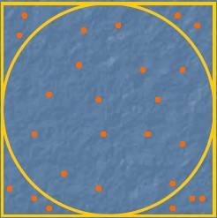
Cont.
area.of .circle ₌ #.o.f...dots.inside.circle
area.of .square total.number.of .dots
Hit and miss algorithm
♣ Generate two sequences of N of PRN :: Ri,,Rj
♣
Xi=-1+2R i
♣ Yj=-1+2R j
♣ Start from s=zero
♣ If (X²+Y²<1) s=s+1
♣ # of dots inside circle=s
♣ total number of dots=N
π = 4* S / N

Slide 9
Example 1. HERFY Cake Shop
The cake seller HERFY shop sells a random number of cakes each day. HERFY manager wants to determine a policy for managing his inventory of cakes (e.g. how many cakes should he prepare in 10 days).
Demand Frequency Probability for
cakes
0 | 10 | 0.05 | =10/200
1 | 20 | 0.1
2 | 40 | 0.2
3 | 60 | 0.3
4 | 40 | 0.2
5 30 0.15
200 |  | 1.00
We can use Monte Carlo simulation to analyze HERFY inventory…

Slide 10
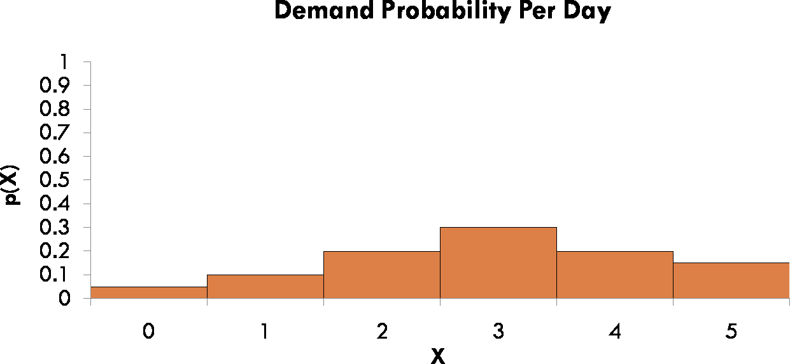
Example 1. HERFY Cake Shop
Step 1: Set up the probability distribution for cake sales.
Using historical data HERFY Shop determined that 5% of the time 0 cakes were demanded, 10% of the time 1 cake was demanded, etc…
P(1) = 10%

Slide 11
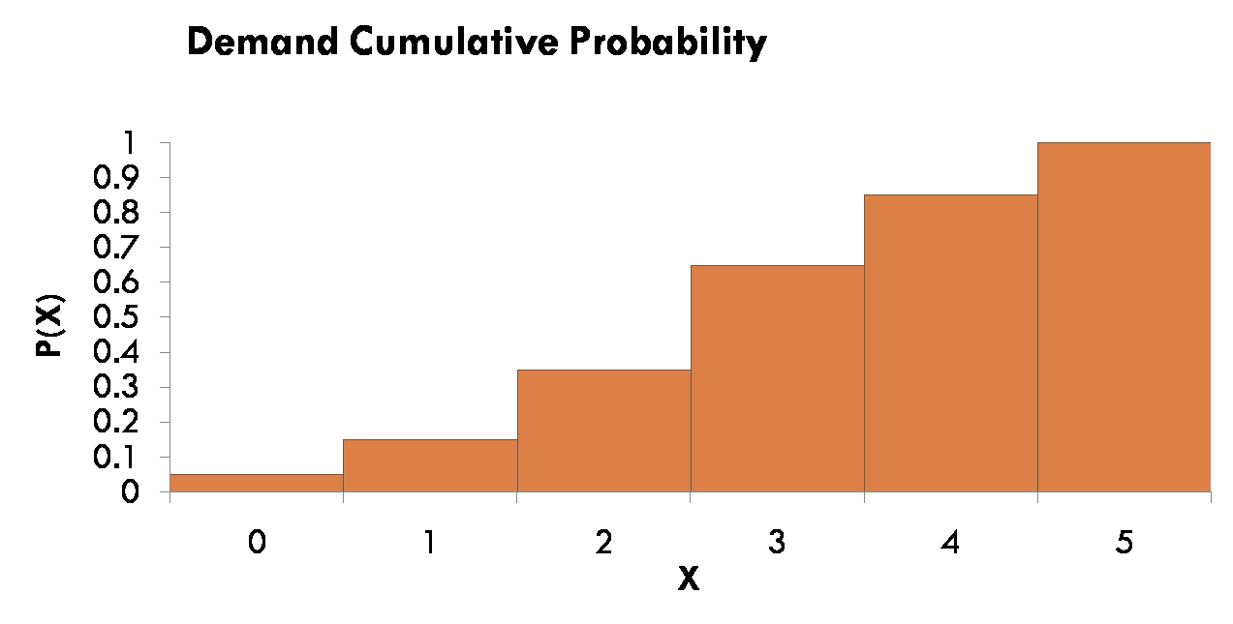
Example 1. HERFY Cake Shop
Step 2: Build a Cumulative Probability Distribution
15% of the time the demand was 0 or 1 cake P(0) = 5% + P(1) = 10%

Slide 12



Example 1. HERFY Cake Shop
Step 3: Establish an interval of random numbers.
Probability
Demand
Random
Number Interval
0
1
2
3
4
5
10 0.05 0.05 01 - 05
20 0.10 0.15 06 - 15
40 0.20 0.35 16 - 35
60 0.30 0.65 36 - 65
40 0.20 0.85 66 - 85
30 0.15 1.00 86 - 00
Must be in correct proportion
Note: 5% of the time 0 cakes are demanded, so the random number interval contains 5% of the numbers between 1 and 100

Slide 13
Example 1. HERFY Cake Shop Step 4: Generate random numbers.
52 | 06 | 50 | 88 | 53 | 30 | 10 | 47 | 99 | 37 | 66 | 91 | 35 | 32 | 00 | 84 | 57 | 07
37 | 63 | 28 | 02 | 74 | 35 | 24 | 03 | 29 | 60 | 74 | 85 | 90 | 73 | 59 | 55 | 17 | 60
82 | 57 | 68 | 28 | 05 | 94 | 03 | 11 | 27 | 79 | 90 | 87 | 92 | 41 | 09 | 25 | 36 | 77
69 | 02 | 36 | 49 | 71 | 99 | 32 | 10 | 75 | 21 | 95 | 90 | 94 | 38 | 97 | 71 | 72 | 49
98 | 94 | 90 | 36 | 06 | 78 | 23 | 67 | 89 | 85 | 29 | 21 | 25 | 73 | 69 | 34 | 85 | 76
96 | 52 | 62 | 87 | 49 | 56 | 59 | 23 | 78 | 71 | 72 | 90 | 57 | 01 | 98 | 57 | 31 | 95
33 | 69 | 27 | 21 | 11 | 60 | 95 | 89 | 68 | 48 | 17 | 89 | 34 | 09 | 93 | 50 | 44 | 51
50 | 33 | 50 | 95 | 13 | 44 | 34 | 62 | 64 | 39 | 55 | 29 | 30 | 64 | 49 | 44 | 30 | 16
88 | 32 | 18 | 50 | 62 | 57 | 34 | 56 | 62 | 31 | 15 | 40 | 90 | 34 | 51 | 95 | 26 | 14
90 | 30 | 36 | 24 | 69 | 82 | 51 | 74 | 30 | 35 | 36 | 85 | 01 | 55 | 92 | 64 | 09 | 85
50 | 48 | 61 | 18 | 85 | 23 | 08 | 54 | 17 | 12 | 80 | 69 | 24 | 84 | 92 | 16 | 49 | 59
27 | 88 | 21 | 62 | 69 | 64 | 48 | 31 | 12 | 73 | 02 | 68 | 00 | 16 | 16 | 46 | 13 | 85
45 | 14 | 46 | 32 | 13 | 49 | 66 | 62 | 74 | 41 | 86 | 98 | 92 | 98 | 84 | 54 | 33 | 40
81 | 02 | 01 | 78 | 82 | 74 | 97 | 37 | 45 | 31 | 94 | 99 | 42 | 49 | 27 | 64 | 89 | 42
66 | 83 | 14 | 74 | 27 | 76 | 03 | 33 | 11 | 97 | 59 | 81 | 72 | 00 | 64 | 61 | 13 | 52
74 | 05 | 82 | 82 | 93 | 09 | 96 | 33 | 52 | 78 | 13 | 06 | 28 | 30 | 94 | 23 | 37 | 39
30 | 34 | 87 | 01 | 74 | 11 | 46 | 82 | 59 | 94 | 25 | 34 | 32 | 23 | 17 | 01 | 58 | 73

Slide 14
Example 1. HERFY Cake Shop
Step 5: Simulate a series of trials.
Using random number table on previous slide, simulated demand for 10 days is:
Tires Demanded
Interval of Random Numbers
0
1
2
3
4
5
01 - 05
06 - 15
16 - 35
36 - 65
66 - 85
86 - 100
2
3
1
Random number: | 52 | 06 50 88 | 53 | 30 |  | 10 | 47 |  | 99 | 37
Simulated demand: | 3 | 1 3 5 | 3 | 2 | 1 |  | 3 | 5 | 3

